Slide 1




DEEP LEARNING
GAN PART A, CA2
Shen Lei and Xavier Lee

Slide 2
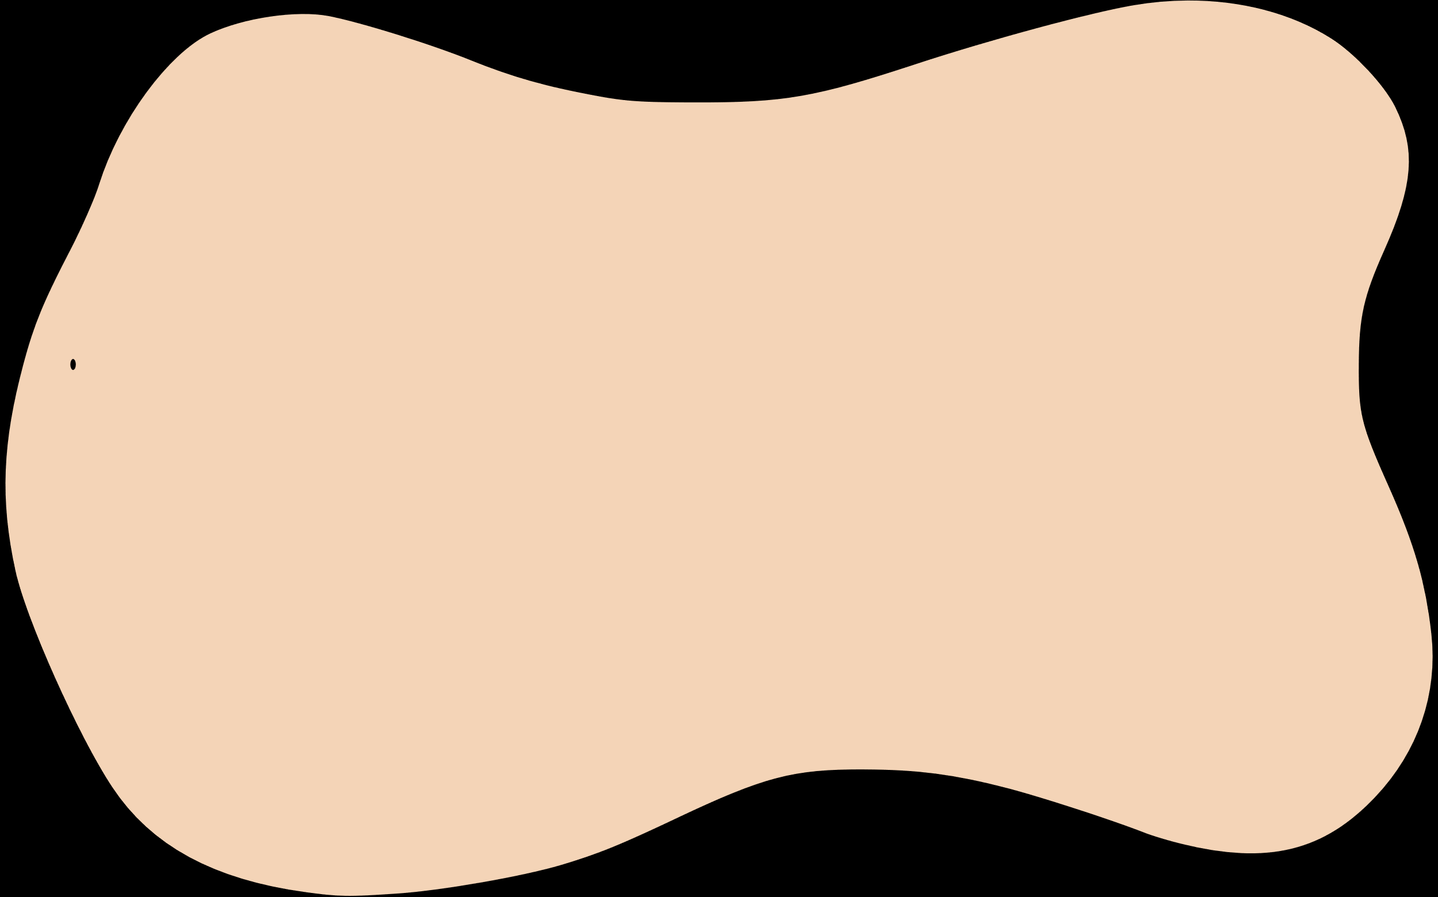
BACKGROUND INFORMATION
Today, we will be using Generative Adversarial Networks (GANs) on an EMNIST dataset provided. This presentation will demonstrate the challenges and workflow involved to be able to generate realistic handwritten letters to the best of our ability exploring different GAN architectures.
Will we pass the Turing test? ;)

Slide 3
Our Workflow
1
2
Exploratory data analysis
Data preprocessing
3
4
Feature engineering
Model exploration and experimentation
5
6
Model Improvement
Final statements

Slide 4

Exploratory data analysis

Slide 5
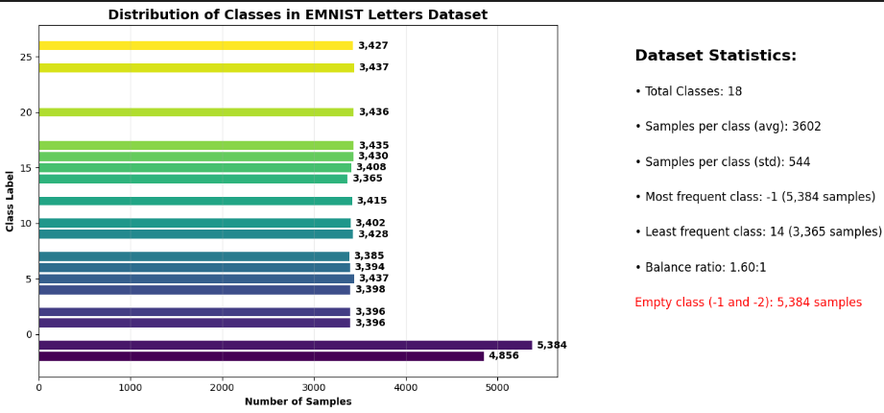
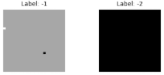
EXPLORATORY DATA ANALYSIS
Observations:
Range of classes: -2 → 26
Negative classes are empty, meaning Class -1 and Class -2 are not useful for training. Thus, should be dropped.

Slide 6
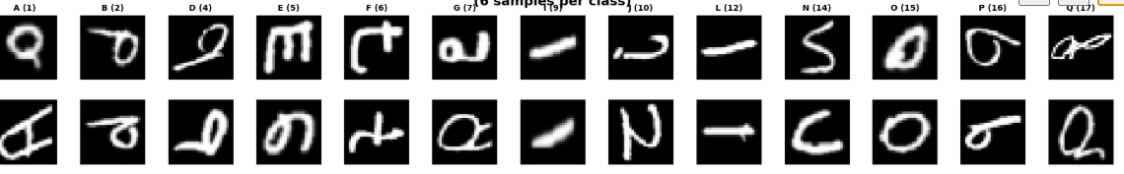
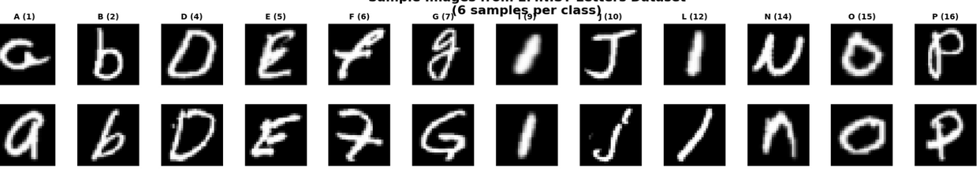
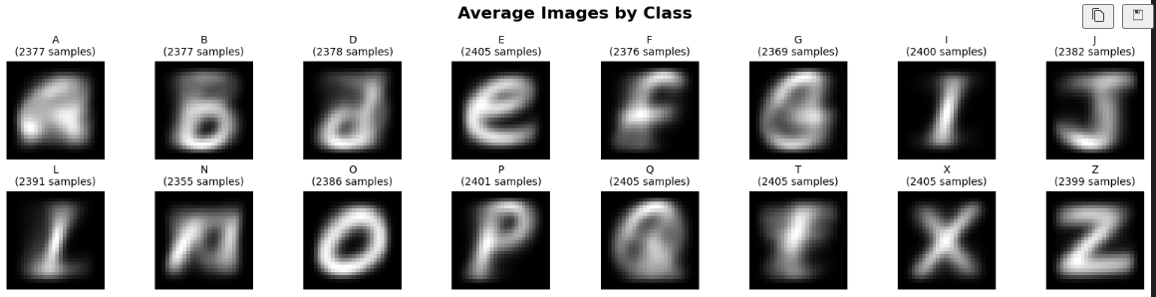
EXPLORATORY DATA ANALYSIS
Before orientation correction:
Observations:
Class 1 starts from A and ends with Class 26 which is Z.
Without any processing, our letters appear to be in a wrong orientation.
After correction
After orientation correction:
Image averaging observations:
Letters where the capitalization of it differs largely from upper & lower (A, B, G, Q)
The average of these letters are blury and hard to distinguish the letter
Hard to see distinct features like corners and edges.
Image averaging:

Slide 7
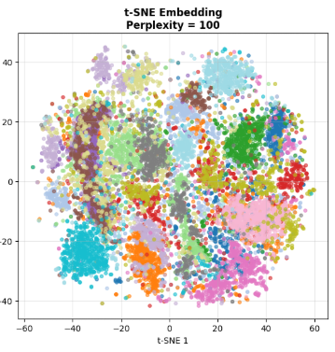
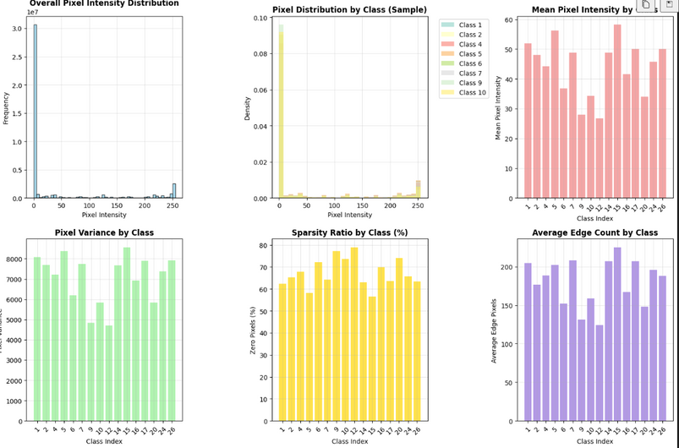
EXPLORATORY DATA ANALYSIS
t-SNE observations:
The visual separation across t-SNE embeddings suggests that the dataset has underlying structure that can be captured non-linearly.
Some character classes may overlap due to visual similarity (e.g., 'C' and 'G'), but many appear distinguishable.
This type of analysis is valuable for pre-model inspection to assess class separability and for debugging latent feature quality in deep learning pipelines.
Pixel observations:
Most pixels are background; strokes peak at intensity 255.
Classes vary in brightness (lightest: 9, darkest: 16) and variance (highest: 16, lowest: 10).
Sparsity ranges from very sparse (10) to dense (14).
Edge complexity highest in 14, lowest in 10.

Slide 8


Data preprocessing/
Feature engineering

Slide 9
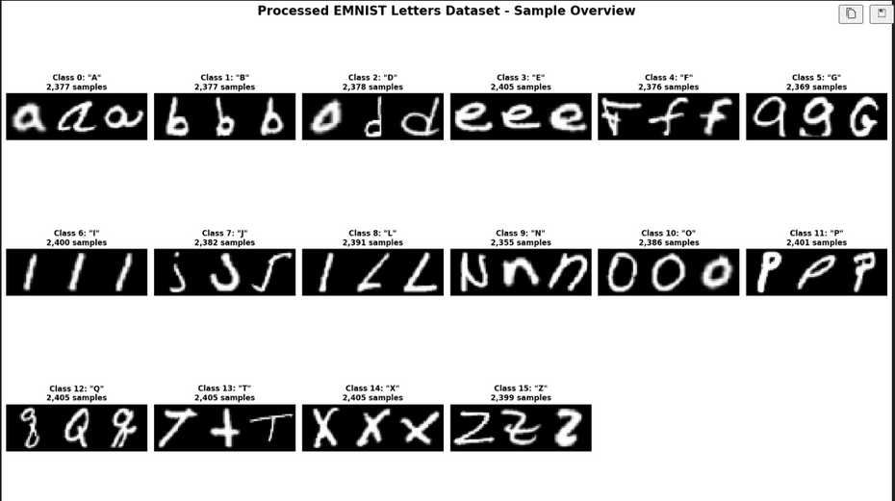
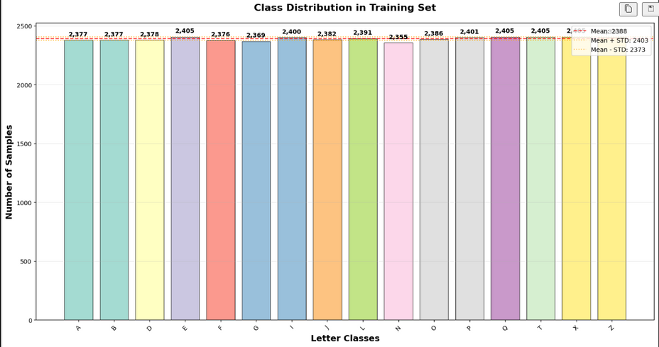
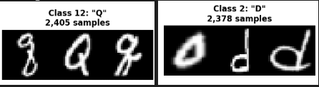
DATA PREPROCESSING / FEATURE ENGINEERING
Data Preprocessing & Feature Engineering Summary:
Label Mapping: Filtered EMNIST to valid letter classes (1–26) and remapped to consecutive 0-based indices; created letter ↔ class mappings.
Normalization: Scaled pixel values to [-1, 1] (tanh) for GAN compatibility.
Label Transformation: Mapped original labels to new indices, removing invalid ones.
Data Augmentation: Applied rotation (-/+ 10°), translation (-/+ 2 px), and Gaussian noise to increase variability.
we can observe that some letters are unclean and harmful for our model as shown here:
However, due to the nature of our dataset. It will be very time consuming to go through the dataset and remove the harmful data one by one. We should not do further processing and cleaning.

Slide 10

Model exploration and experimentation

Slide 11
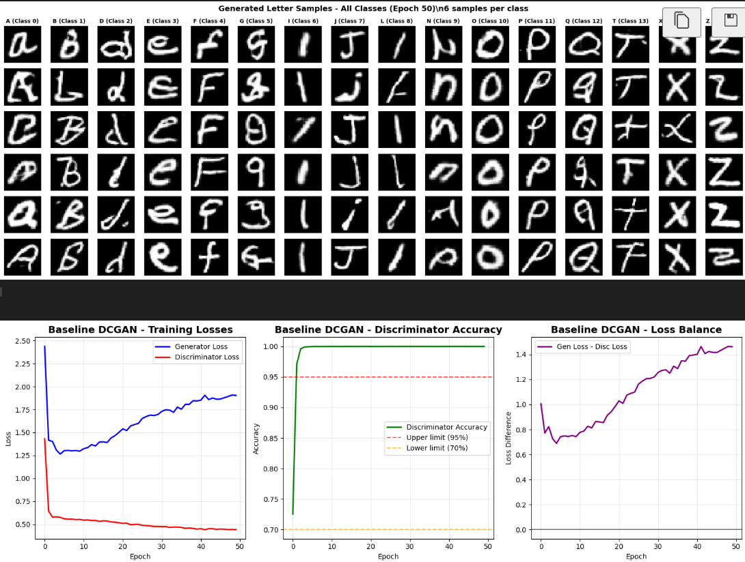
BASE MODEL / DCGAN
Observation:
Generated Samples: Most letters are recognizable, but some (e.g., G, Q, N) show distortion and inconsistency.
Training Losses: Discriminator loss is steadily decreasing while generator loss rises → discriminator dominating over time.
Discriminator Accuracy: Remains 100%, this suggests overfitting and poor generator feedback.
Loss Balance: Gap between generator and discriminator loss widens, indicating training imbalance.
Architecture:
Standard Generator: Classic DCGAN generator with Conv2DTranspose layers
Standard Discriminator: Classic DCGAN discriminator with Conv2D layers
4 conv layers for both discriminator and generator

Slide 12
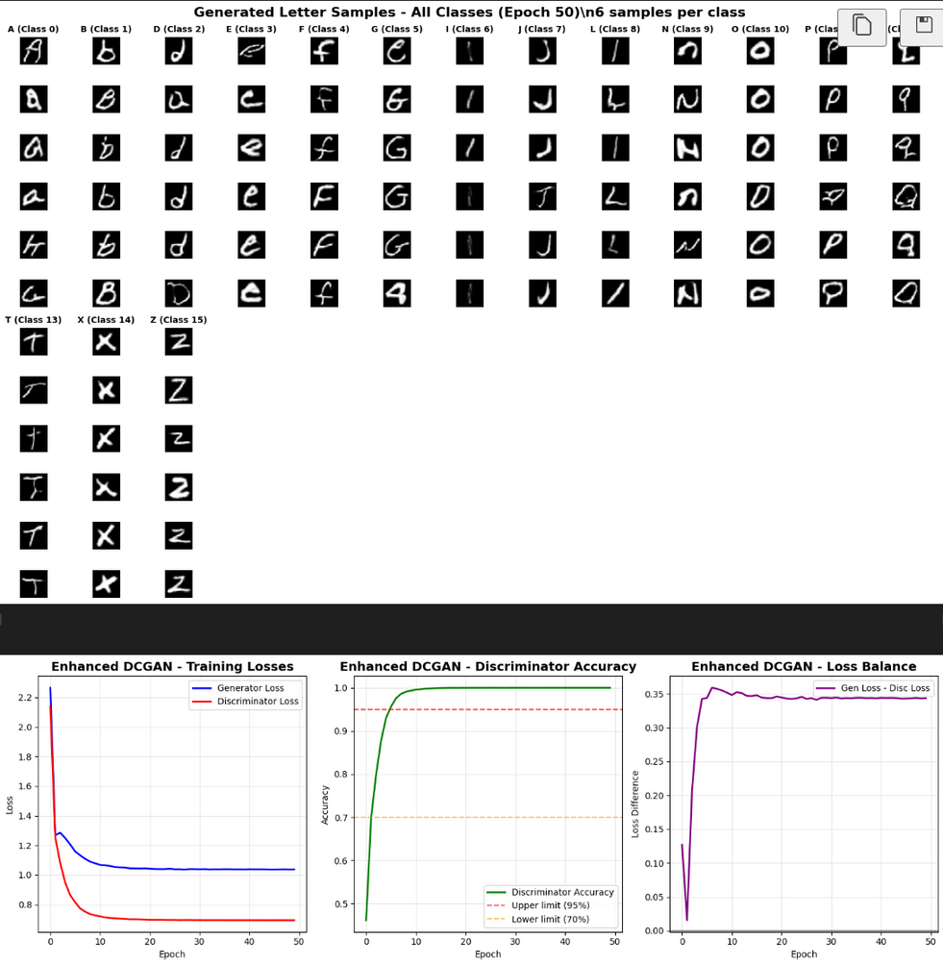
ENHANCED MODEL / DCGAN
Observation:
Generated Samples: Letters are sharper and more consistent than baseline; however, some (e.g., G, Q, O) remain distorted, and several classes (T, X, Z) show repetitive patterns.
Training Losses: Both generator and discriminator losses converge quickly to low values, indicating stable training but possible early saturation.
Discriminator Accuracy: Stays near 100% after a few epochs → discriminator still too strong.
Loss Balance: Small, steady gap between losses suggests improved stability over baseline but still biased toward the discriminator.
Architecture:
Enhanced Generator: + Residual blocks
Enhanced Discriminator: + Spectral normalization

Slide 13
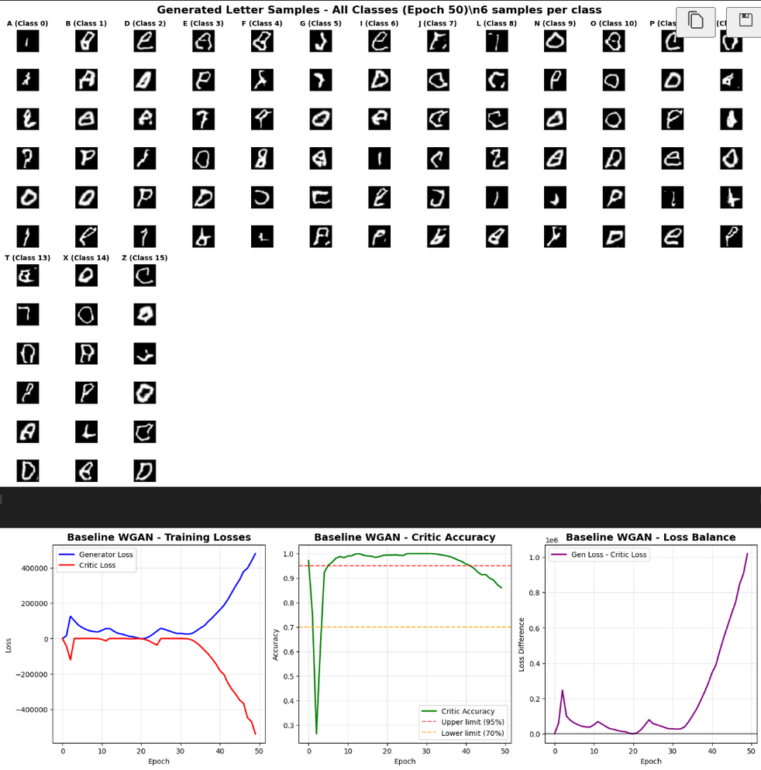
BASE MODEL / WGAN
Observation:
Generated Samples: Many letters are poorly formed or unrecognizable; severe distortions and inconsistent stroke patterns across most classes.
Training Losses: Generator and critic losses fluctuate heavily, with extreme values → unstable training dynamics.
Discriminator Accuracy: Starts stable but declines after around 30 epochs, indicating weakening discriminator performance.
Loss Balance: Extremely large and growing gap suggests severe imbalance between generator and critic.
Architecture:
Standard Generator: Classic WGAN generator with Conv2DTranspose layers
Standard Discriminator: Classic WGAN discriminator with Conv2D layers
4 conv layers for both discriminator and generator

Slide 14
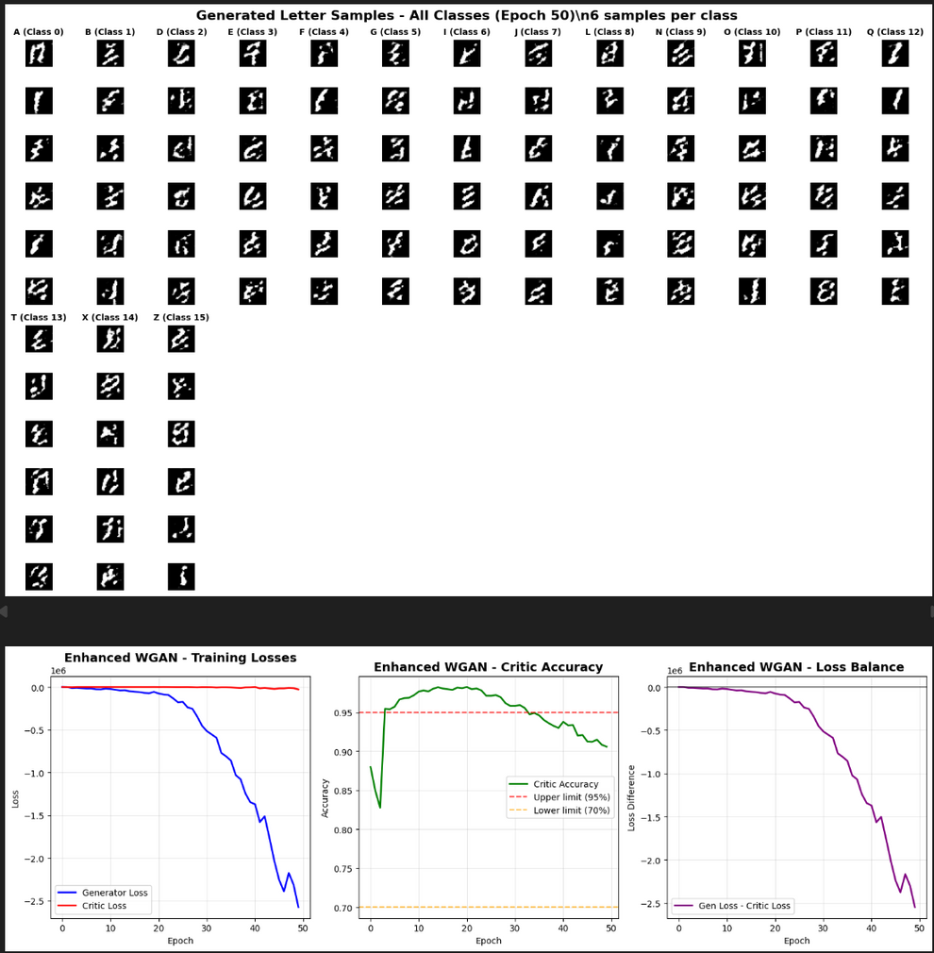
ENHANCED MODEL / WGAN
Observation:
Generated Samples: ALL letters appear beyond unrecognizable, severe distortions and inconsistent stroke patterns across ALL classes.
Training Losses: Generator and critic losses fluctuate heavily, with extreme values → unstable training dynamics.
Discriminator Accuracy: Starts stable but declines after around 30 epochs, indicating weakening discriminator performance.
Loss Balance: Extremely large and growing gap suggests severe imbalance between generator and critic.
Architecture:
Enhanced Generator: + spectral normalization
Enhanced Discriminator: + residual block

Slide 15
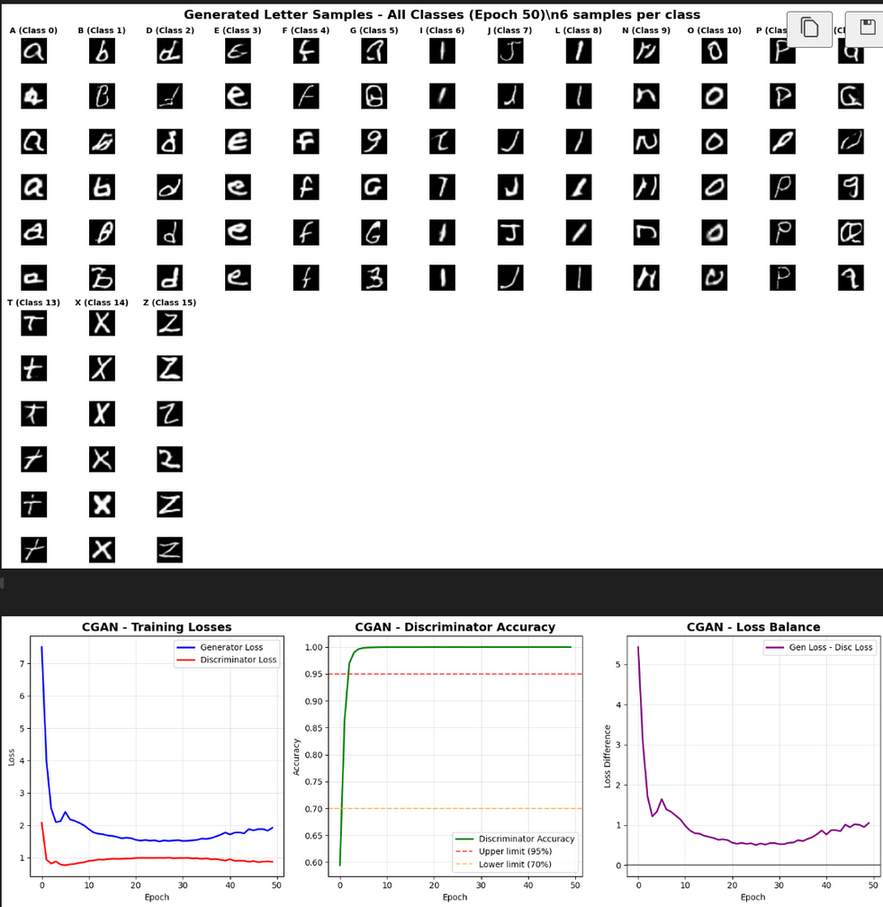
BASE MODEL / CGAN
Observation:
Generated Samples: Letters are mostly recognizable with better structure than some GAN variants, but several classes with slight inconsistencies.
Training Losses: Both generator and discriminator losses stabilize after early sharp drops, indicating balanced but possibly slow improvement.
Discriminator Accuracy: Rapidly reaching 99% and stays there, suggesting discriminator dominance and potential generator underfitting.
Loss Balance: Steep early drop followed by stabilization near low values
Architecture:
Standard Generator: Classic DCGAN generator with Conv2DTranspose layers
Standard Discriminator: Classic DCGAN discriminator with Conv2D layers
4 conv layers for both discriminator and generator

Slide 16
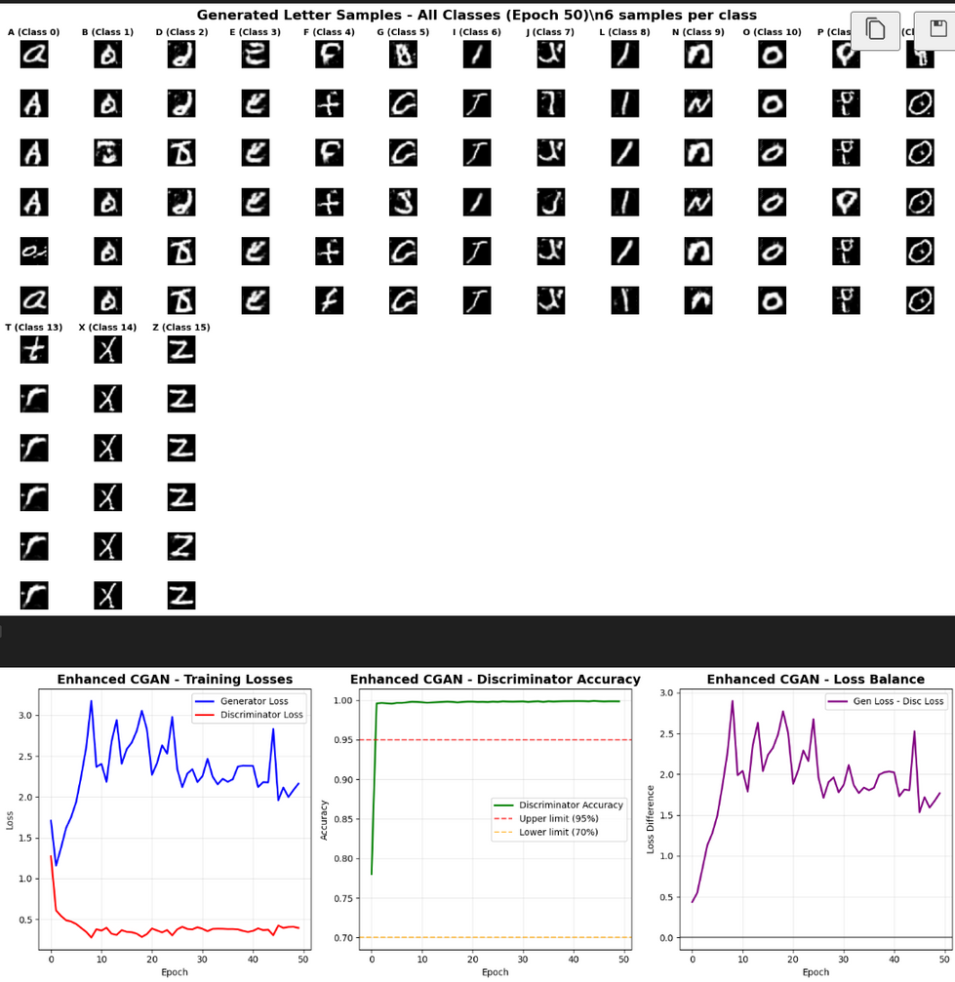
ENHANCED MODEL / CGAN
Observation:
Generated Samples: Letters appear to be worst than basic CGAN, however there are still some letters that maintain their quality and sharpness
Training Losses: Generator loss is highly volatile, indicating unstable adversarial learning, while discriminator loss remains low and stable.
Discriminator Accuracy: Large, fluctuating gap between losses shows persistent training imbalance.
Architecture:
Enhanced Generator: + spectral normalization
Enhanced Discriminator: + residual block

Slide 17
Model improvement /hyperparameter tuning

Slide 18
MODEL IMPROVEMENT
Spectral normalization
Residual block
Spectral Normalization is a technique that stabilizes GAN training by scaling each weight matrix so its largest singular value is fixed at 1. This enforces a Lipschitz constraint, helping control exploding gradients and making the discriminator’s output changes more predictable.
Why it might not help for our dataset. Since EMNIST consists of small, grayscale handwritten letters with relatively low complexity, the risk of severe gradient instability is minimal. Applying SN here could unnecessarily limit the discriminator’s capacity, slow down training, and add computation cost without offering meaningful stability gains.
Residual Blocks are neural network components that add a shortcut connection from a layer’s input to its output. Instead of learning the full transformation, the block learns the residual (the difference between input and output). This helps gradients flow more easily through deep networks, reducing vanishing gradient issues and improving training stability.
Why it might not help for our dataset? EMNIST images are low-resolution and the models used for them are typically shallow compared to large-scale vision tasks. Adding residual blocks could increase complexity without a clear performance boost, and might even lead to overfitting due to the relatively small amount of information in each image.

Slide 19
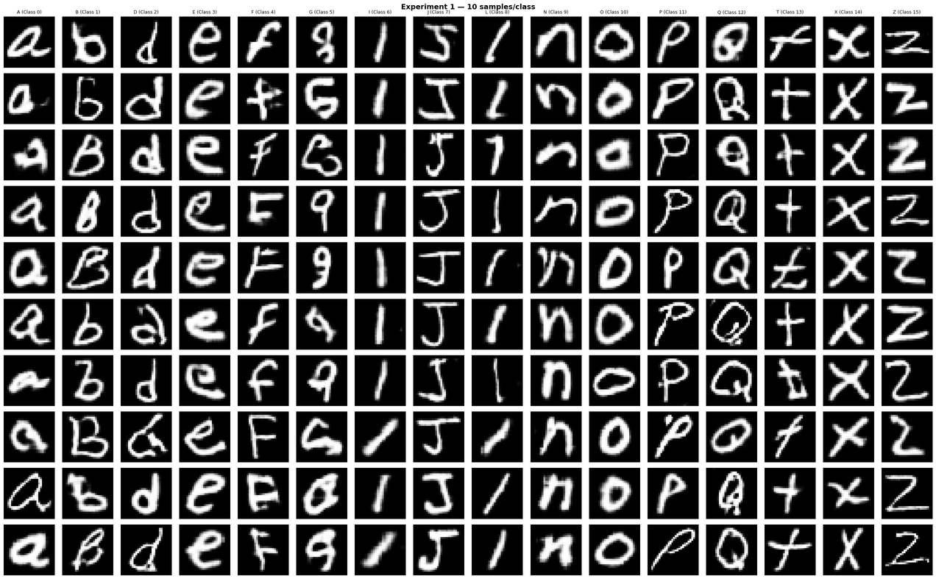
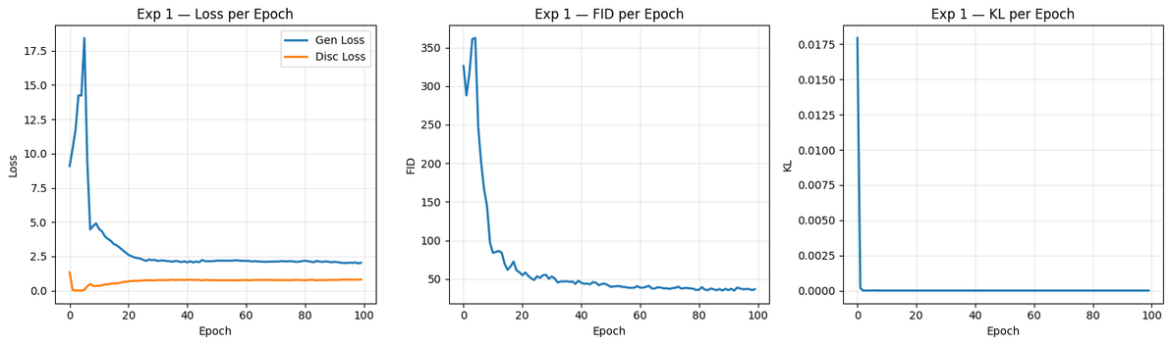
HYPERTUNED BASIC CGAN
Observation:
Generated Samples: Letters are clean, well-structured, and consistent across classes, showing strong style preservation and minimal distortion.
Loss Trends: Generator loss stabilizes after an early spike; discriminator loss remains low and steady, suggesting balanced adversarial training.
FID Scores: Sharp decline in early epochs, reaching low values, indicating improved realism and diversity of generated images.
KL Divergence: Low and stable, showing the model maintains class separation and diversity without mode collapse.
Architecture:
Uses same architecture as CGAN
Best parameters:
generator learning rate: 0.0002
discriminator learning rate: 0.0002
batch size: 64
epochs: 100

Slide 20
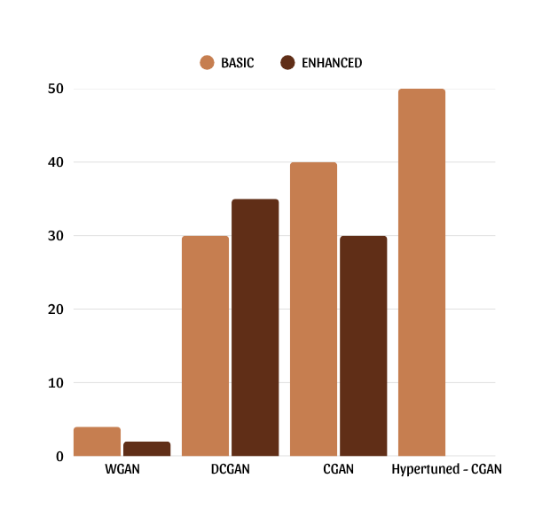
ANALYSIS
By comparing all our models, it appears that CGAN is inherently superior in learning and generating handwritten letters. Looking from our basic DCGAN (our baseline model) we can safely choose CGAN as our best model yet.

Slide 21
THANK YOU

